Slide 1
IBM DATA SCIENCE CAPSTONE PROJECT REPORT
SpaceX Falcon 9 First Stage Landing Prediction
End-to-End Machine Learning Pipeline, Geospatial Analytics & Launch Cost Optimization
Author: Candidate | Course: Applied Data Science Capstone | Date: October 2026
Project GitHub URL: https://github.com/your-username/SpaceX-Falcon9-Landing-Prediction

Slide 2
IBM DATA SCIENCE CAPSTONE PROJECT
Executive Summary: Project Scope & Key Results
Project Motivation & Methodology
Business Goal: SpaceX advertises Falcon 9 launches at ~$62M, drastically undercutting competitors (~$165M) because the first stage booster is reusable. Predicting landing success enables competitive bidding.
Data Pipeline: Extracted 90 past launches via SpaceX REST API v4 and scraped supplementary historical tables from Wikipedia using BeautifulSoup.
Data Wrangling: Handled missing payload values, created binary target variable Class (1 = success, 0 = failure), and one-hot encoded categorical features.
Analytics: Conducted EDA using Matplotlib/Seaborn and SQL. Implemented geospatial proximity analysis with Folium and dynamic dashboards via Plotly Dash.
Key Insights & Business Outcomes
Reusability Maturity: Landing success rates improved dramatically from 0% (2010–2013) to over 85% by 2020 due to Falcon 9 Block 5 iteration.
Launch Site Dominance: KSC LC-39A is the top-performing launch pad with a 76.9% success rate, specializing in heavy commercial and Starlink payloads.
Optimal Model Performance: Trained 4 supervised classifiers using 10-fold GridSearchCV. All models achieved 83.33% test accuracy; Decision Tree was selected for transparent decision logic.
Commercial Takeaway: High payload mass (>5,000 kg) correlates strongly with Drone Ship (ASDS) recoveries. Competitors must invest in sea recovery vessels to compete.
GitHub Repository Reference: https://github.com/your-username/SpaceX-Falcon9-Landing-Prediction

Slide 3
IBM DATA SCIENCE CAPSTONE PROJECT
Introduction: Aerospace Revolution & Problem Formulation
Background: Commercial Launch Industry
The Cost Paradigm: Traditionally, rocket stages were expendable, burned up in the atmosphere or plunged into the ocean, costing hundreds of millions per launch.
SpaceX Disruption: SpaceX engineered the Falcon 9 first stage booster to perform autonomous boostback, entry, and landing burns on drone ships (ASDS) or landing zones (RTLS).
Economic Advantage: Reusing the booster cuts manufacturing and launch costs by over 60%, establishing SpaceX as the undisputed market leader.
Problem Statement & Decision Objective
The Core Problem: Can we reliably predict whether a Falcon 9 first stage will land successfully prior to launch based on payload mass, orbit type, launch site, and flight characteristics?
Strategic Value: If a competitor or satellite operator knows the booster landing outcome, they can accurately estimate the true launch cost of a flight.
Deliverable: A robust classification model and an interactive business intelligence suite to support strategic bidding and mission risk assessment.
GitHub Repository Reference: https://github.com/your-username/SpaceX-Falcon9-Landing-Prediction

Slide 4
IBM DATA SCIENCE CAPSTONE PROJECT
Data Collection: SpaceX REST API Pipeline
API Extraction Flowchart & Architecture
Endpoint Target: https://api.spacexdata.com/v4/launches/past
Filtering Protocol: Filtered JSON responses where rocket identifier matches Falcon 9 (excluding Falcon 1 test flights).
Sub-resource Enrichment: Iterated over nested IDs using custom functions:
• getBoosterVersion(): Extracts booster serial and block version.
• getLaunchSite(): Extracts launchpad names and geographic coordinates.
• getPayloadData(): Extracts payload mass (kg) and destination orbit.
• getCoreData(): Extracts landing outcome, landing pad, and reuse count.
Dataset Structure: Tabulated 90 launches with 17 operational parameters.
Key Code Snippets & Extracted Features
Python Stack: requests, pandas, json, datetime
Core Data Schema: FlightNumber, Date, BoosterVersion, PayloadMass, Orbit, LaunchSite, Outcome, Flights, GridFins, Reused, Legs, LandingPad, Block, ReusedCount, Serial.
Sample Output: Constructed unified Pandas DataFrame representing launches from 2010-06-04 to 2020-11-05.
Quality Verification: Validated response status codes (200 OK) and normalized nested dictionaries into flat columnar formats.
GitHub Repository Reference: https://github.com/your-username/SpaceX-Falcon9-Landing-Prediction/blob/main/1_SpaceX_Data_Collection_API.ipynb

Slide 5
IBM DATA SCIENCE CAPSTONE PROJECT
Data Collection: Web Scraping Historical Launches
Web Scraping Methodology Flowchart
Source Target: Wikipedia: "List of Falcon 9 and Falcon Heavy launches"
HTML Fetching: Issued HTTP GET requests using Python requests library with browser User-Agent headers.
Document Parsing: Parsed DOM tree using BeautifulSoup(response.text, "html.parser").
Table Identification: Located HTML table elements with class "wikitable" spanning launch years 2010 through 2020.
Row Iteration: Extracted <th> and <td> tags, mapping column indices to tabular flight metrics.
Text Parsing, Cleaning & Normalization
String Cleaning: Stripped footnote citations (e.g., "[1]", "[b]") and trailing newline characters (\n).
Date & Time Normalization: Extracted ISO standard date strings and launch times from concatenated table strings.
Payload Mass Parsing: Parsed numerical kilograms from heterogeneous strings containing lbs and kg measurements.
Outcome Standardization: Standardized launch and landing outcome strings for cross-validation against the REST API dataset.
GitHub Repository Reference: https://github.com/your-username/SpaceX-Falcon9-Landing-Prediction/blob/main/2_SpaceX_Data_Collection_Web_Scraping.ipynb

Slide 6
IBM DATA SCIENCE CAPSTONE PROJECT
Data Wrangling & Feature Engineering
Data Preprocessing & Cleaning Protocols
Missing Value Handling: Identified missing entries in PayloadMass column. Imputed missing values using the attribute mean (~6,104.95 kg).
Target Variable Definition (Class): Analyzed the Outcome column consisting of landing outcomes:
• Success (Class = 1): True Ocean, True RTLS (Ground Pad), True ASDS (Drone Ship).
• Failure (Class = 0): False Ocean, False RTLS, False ASDS, None ASDS, None None.
Class Distribution: Dataset consists of 60 successful landings (66.7%) and 30 unsuccessful landings (33.3%).
Feature Engineering & One-Hot Encoding
Feature Selection: Extracted relevant predictive features: FlightNumber, PayloadMass, Orbit, LaunchSite, Flights, GridFins, Reused, Legs, LandingPad, Block, ReusedCount.
One-Hot Encoding: Applied pd.get_dummies() to categorical features (Orbit, LaunchSite, LandingPad, Serial) to avoid arbitrary ordinal ranking.
Feature Matrix Expansion: Expanded the original feature space into 83 numeric indicator columns.
Casting & Export: Cast all features to float64 for scikit-learn compatibility and serialized to CSV for modeling.
GitHub Repository Reference: https://github.com/your-username/SpaceX-Falcon9-Landing-Prediction/blob/main/3_SpaceX_Data_Wrangling.ipynb

Slide 7
IBM DATA SCIENCE CAPSTONE PROJECT
Exploratory Data Analysis: Visualization Strategy
Summary of Exploratory Visualizations & Analytical Purpose
Flight Number vs. Launch Site (Scatter): Analyzes the chronological usage and landing success evolution across Cape Canaveral (CCAFS/KSC) and Vandenberg (VAFB).
Payload Mass vs. Launch Site (Scatter): Evaluates launchpad payload capacity and whether heavy payloads correlate with landing failures at specific sites.
Success Rate by Orbit Type (Bar Chart): Identifies orbital trajectories that offer higher margins for booster recovery (e.g., LEO vs. high-energy GTO).
Flight Number vs. Orbit Type (Scatter): Traces the chronological evolution of satellite mission types over the 10-year launch history.
Payload Mass vs. Orbit Type (Scatter): Dissects the payload mass distribution demanded by different mission destinations and their recovery outcomes.
Yearly Success Rate Trend (Line Chart): Measures technological learning curves, tracking Falcon 9 booster recovery success rate from inception to maturity.
GitHub Repository Reference: https://github.com/your-username/SpaceX-Falcon9-Landing-Prediction/blob/main/4_SpaceX_EDA_Data_Visualization.ipynb

Slide 8
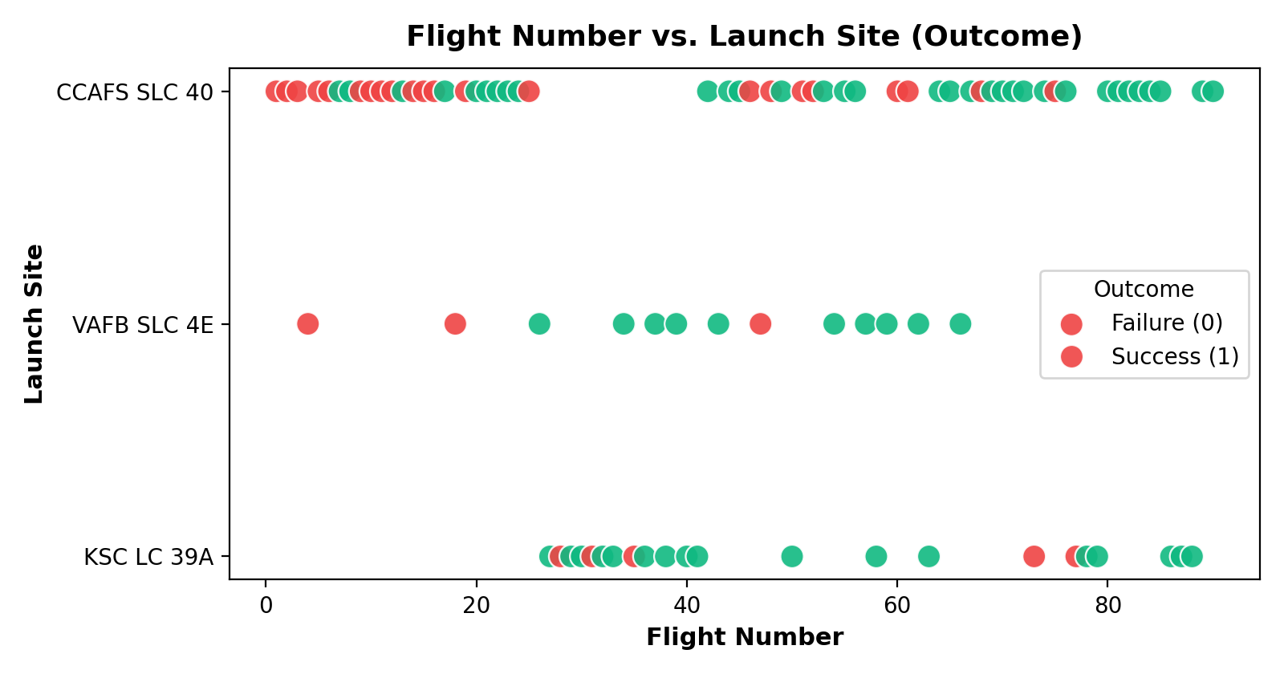
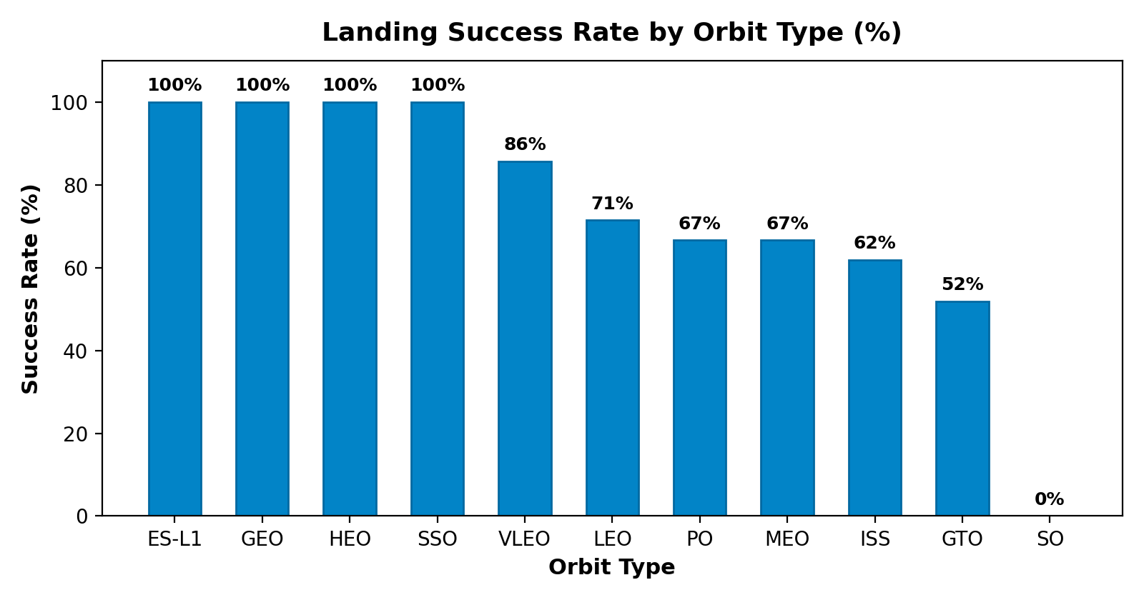
IBM DATA SCIENCE CAPSTONE PROJECT
EDA Visualization Findings: Patterns & Trends
Flight Number & Site Findings
Learning Curve: Early flights (1-30) concentrated at CCAFS LC-40 suffered multiple failures during recovery R&D.
Pad Specialization: KSC LC-39A demonstrates a dominant success rate; VAFB handles polar orbits with high reliability.
Orbit Type Success Findings
100% Success Orbits: ES-L1, GEO, HEO, and SSO achieved perfect 100% recovery rates.
High Energy Orbits: GTO missions demand significant fuel for velocity change, yielding ~60-70% recovery success.
GitHub Repository Reference: https://github.com/your-username/SpaceX-Falcon9-Landing-Prediction/blob/main/4_SpaceX_EDA_Data_Visualization.ipynb

Slide 9
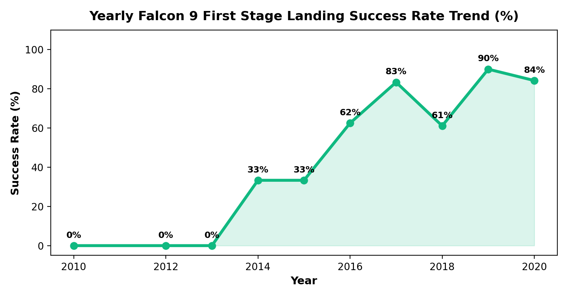
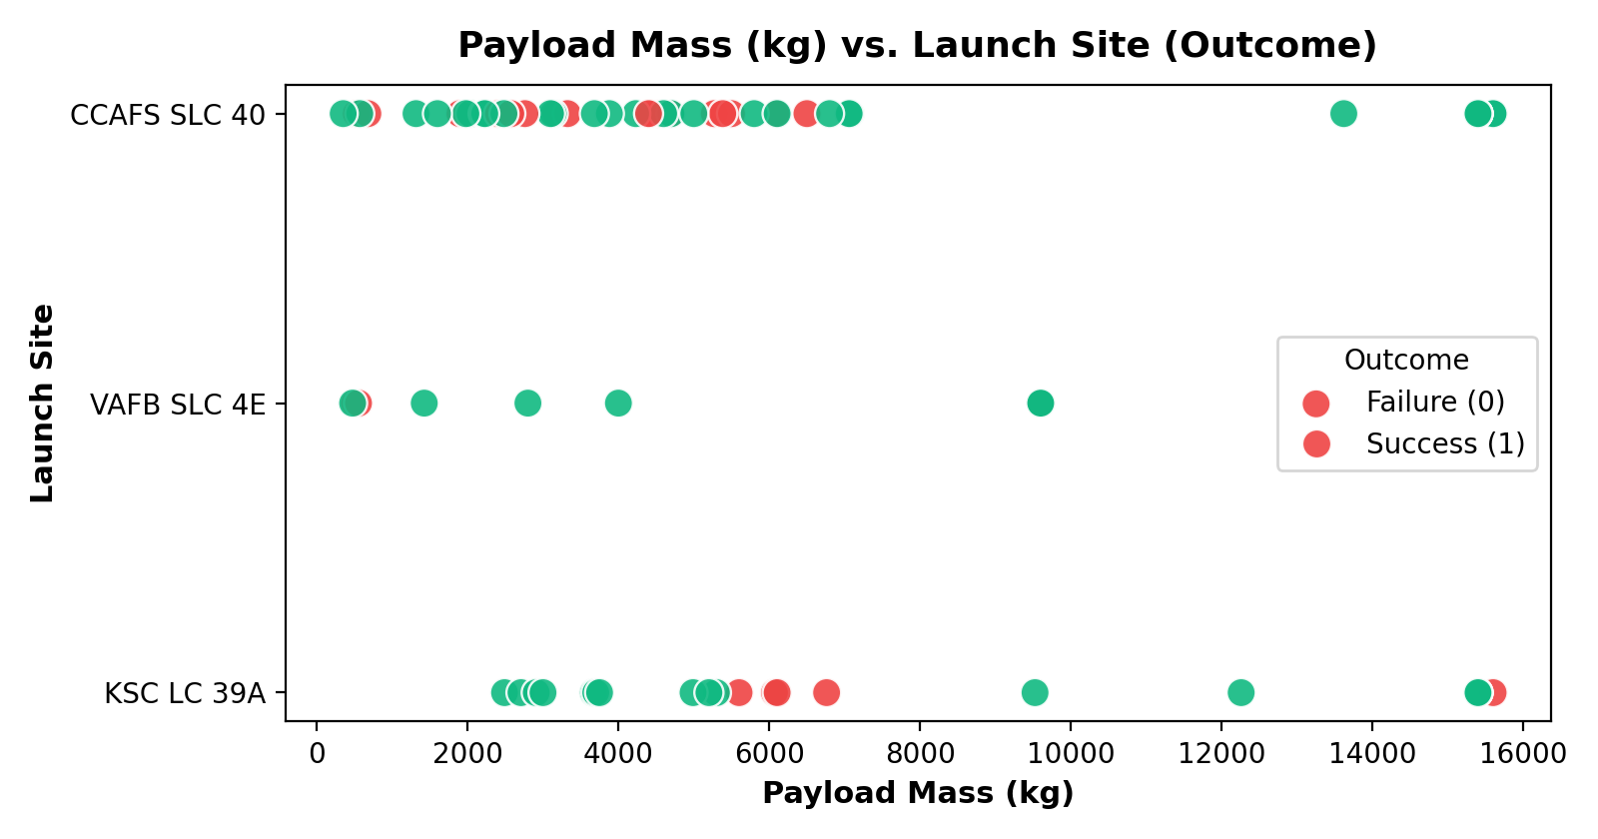
IBM DATA SCIENCE CAPSTONE PROJECT
EDA Visualization: Yearly Evolution & Payload Impact
Yearly Success Rate Trend
Zero Phase (2010-2013): Zero successful landings during initial controlled descent testing in the ocean.
Breakthrough & Maturity: Jumped from 33% in 2014 to 67% in 2017, stabilizing above 80-85% from 2018 onwards.
Payload Mass Distribution
Heavy Mass Recoveries: Payloads > 5,000 kg frequently landed on Drone Ships (ASDS) with high success rates.
VAFB Capacity: VAFB SLC-4E primarily handled lightweight payloads (< 5,000 kg) to polar and Sun-synchronous orbits.
GitHub Repository Reference: https://github.com/your-username/SpaceX-Falcon9-Landing-Prediction/blob/main/4_SpaceX_EDA_Data_Visualization.ipynb

Slide 10
IBM DATA SCIENCE CAPSTONE PROJECT
EDA with SQL: Database Architecture & Queries
SQL Setup & Query Catalog
Database Engine: Loaded SpaceX dataset into SQLite / IBM DB2 relational database table (SPACEXTBL).
Query 1 - Distinct Sites: SELECT DISTINCT Launch_Site FROM SPACEXTBL;
Query 2 - CCAFS Launches: SELECT * FROM SPACEXTBL WHERE Launch_Site LIKE "CCA%" LIMIT 5;
Query 3 - Total NASA Payload: SELECT SUM(PAYLOAD_MASS__KG_) FROM SPACEXTBL WHERE Customer = "NASA (CRS)";
Query 4 - F9 v1.1 Avg Mass: SELECT AVG(PAYLOAD_MASS__KG_) FROM SPACEXTBL WHERE Booster_Version LIKE "%v1.1%";
Query 5 - First Ground Landing: SELECT MIN(Date) FROM SPACEXTBL WHERE Landing__Outcome = "Success (ground pad)";
Advanced Query Catalog (Queries 6-10)
Query 6 - Drone Ship 4k-6k kg: Boosters landing on drone ship with payload between 4000 and 6000 kg.
Query 7 - Mission Outcomes: SELECT Mission_Outcome, COUNT(*) FROM SPACEXTBL GROUP BY Mission_Outcome;
Query 8 - Max Payload Boosters: SELECT Booster_Version FROM SPACEXTBL WHERE PAYLOAD_MASS__KG_ = (SELECT MAX(PAYLOAD_MASS__KG_) FROM SPACEXTBL);
Query 9 - 2015 Drone Failures: SELECT Date, Booster_Version, Launch_Site FROM SPACEXTBL WHERE Landing__Outcome = "Failure (drone ship)" AND SUBSTR(Date, 1, 4) = "2015";
Query 10 - Outcome Ranking: RANK landing outcomes between 2010-06-04 and 2017-03-20 in descending order.
GitHub Repository Reference: https://github.com/your-username/SpaceX-Falcon9-Landing-Prediction/blob/main/5_SpaceX_EDA_SQL.ipynb

Slide 11
IBM DATA SCIENCE CAPSTONE PROJECT
EDA with SQL: Empirical Findings & Metrics
Core Aggregation Results
Unique Launch Sites: CCAFS LC-40, CCAFS SLC-40, KSC LC-39A, VAFB SLC-4E.
Total NASA Payload Mass: 45,596 kg delivered across Commercial Resupply Services (CRS) flights.
Average F9 v1.1 Payload: 2,928.4 kg average payload mass for version 1.1 boosters.
First Ground Pad Landing: December 22, 2015 (Booster B1019 at Cape Canaveral LZ-1).
Drone Ship 4k-6k kg Boosters: B1022, B1026, B1021.2, B1031.2 successfully landed with medium-heavy communication satellites.
Advanced Ranking & Failure Analysis
Maximum Payload Boosters: Booster variants B1048, B1049, B1051, B1056, B1058, B1060 carried maximum payload of 15,600 kg (Starlink launches).
2015 Drone Ship Failures: Boosters B1012 (2015-01-10) and B1015 (2015-04-14) crashed on drone ship during hydraulic fluid and throttle response R&D.
Outcome Ranking (2010-2017): No attempt (10) and Failure (drone ship) (5) dominated early test flights before Success (drone ship) (5) and Success (ground pad) (3) overtook them.
GitHub Repository Reference: https://github.com/your-username/SpaceX-Falcon9-Landing-Prediction/blob/main/5_SpaceX_EDA_SQL.ipynb

Slide 12
IBM DATA SCIENCE CAPSTONE PROJECT
Interactive Visual Analytics: System Architecture
Folium Geospatial Map Engine
Base Cartography: Initialized OpenStreetMap centered on Florida coastline coordinates (28.56, -80.57).
Launch Pad Markers: Blue circle markers highlighting coordinates of CCAFS LC-40, CCAFS SLC-40, KSC LC-39A, and VAFB SLC-4E.
Marker Clusters: Employed MarkerCluster plugin for flight outcomes (Green markers for Success, Red markers for Failure).
Proximity Calculation: Used Haversine trigonometric formula to measure shortest distance from pads to coastlines, railways, highways, and cities.
Plotly Dash Interactive Application
Framework Architecture: Dash core components (dcc) paired with Dash HTML components (html) and reactive callbacks.
Input Controls: 1. Dropdown menu: "ALL Sites" or specific launchpad selection.
• Input Controls: 2. RangeSlider: Interactive payload mass filter (0 kg to 10,000 kg).
Dynamic Outputs: Pie Chart: Displays total landing success breakdown by launch site.
• Dynamic Outputs: Scatter Plot: Renders Payload Mass vs. Outcome colored by Booster Version category.
GitHub Repository Reference: https://github.com/your-username/SpaceX-Falcon9-Landing-Prediction/blob/main/6_SpaceX_Interactive_Folium.ipynb

Slide 13
IBM DATA SCIENCE CAPSTONE PROJECT
Folium Map Analytics: Launch Site Proximity Insights
Geospatial Site Selection Logic
Coastline Proximity (< 1 km): All launch pads are situated adjacent to coastlines. Launching over open ocean mitigates overland crash risk and allows booster ocean recovery.
Urban Separation (> 20 km): Pads are kept far from dense populations (e.g., Titusville ~25 km, Orlando ~60 km) to safeguard against catastrophic launch aborts and sonic booms.
Transport Corridors (< 1.5 km): Sites are positioned immediately adjacent to railways and major highways (NASA Railroad, Samuel C. Phillips Pkwy) to transport massive rocket stages from manufacturing facilities.
Empirical Distance Measurements
KSC LC-39A to Coastline: ~0.85 km (Shortest trajectory for oceanic launch ascent).
KSC LC-39A to Nearest Highway: ~1.20 km (Immediate heavy equipment access).
KSC LC-39A to Nearest Railway: ~0.75 km (Direct rail link to Cape Canaveral).
KSC LC-39A to Titusville City: ~26.4 km (Safe separation distance zone).
Safety Policy Validation: Confirms strict compliance with Federal Aviation Administration (FAA) and NASA Range Safety regulations.
GitHub Repository Reference: https://github.com/your-username/SpaceX-Falcon9-Landing-Prediction/blob/main/6_SpaceX_Interactive_Folium.ipynb

Slide 14
IBM DATA SCIENCE CAPSTONE PROJECT
Plotly Dash Analytics: Dashboard Findings
Pie Chart: Success Contributions by Site
Overall Launch Success Breakdown: KSC LC-39A contributed 41.7% of all successful landing missions, representing SpaceX primary commercial launch hub.
CCAFS SLC-40 Contribution: Contributed 25.0% of all successful missions, handling high-frequency flights.
VAFB SLC-4E Contribution: Contributed 16.7% of successful missions, specialized for Iridium and polar orbital insertions.
Internal Success Rates: KSC LC-39A boasts a 76.9% internal success rate, outperforming CCAFS SLC-40 (42.9%) and VAFB (40.0%).
Scatter Plot: Payload Mass vs. Outcome
Low-to-Mid Range (2,000 - 4,000 kg): Mixed landing outcomes across early booster versions (v1.0, v1.1). High failure frequency during early drone ship attempts.
Heavy Payload Range (> 5,000 kg): Significantly higher landing success rates. Advanced Falcon 9 FT and B5 versions achieved near-flawless landings.
Booster Version Correlation: Falcon 9 Block 5 (B5) demonstrates 100% landing success across all payload ranges.
Operational Recommendation: Reusability efficiency increases with heavier payloads due to modernized engine throttling.
GitHub Repository Reference: https://github.com/your-username/SpaceX-Falcon9-Landing-Prediction/blob/main/7_spacex_dash_app.py

Slide 15
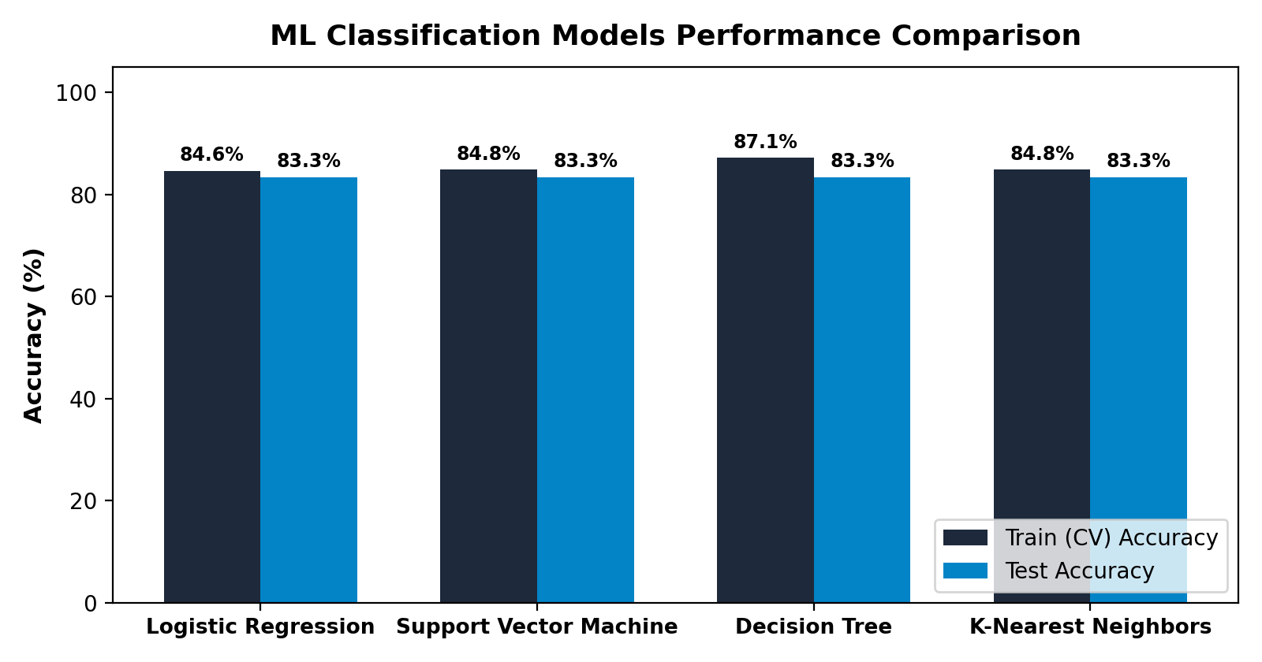
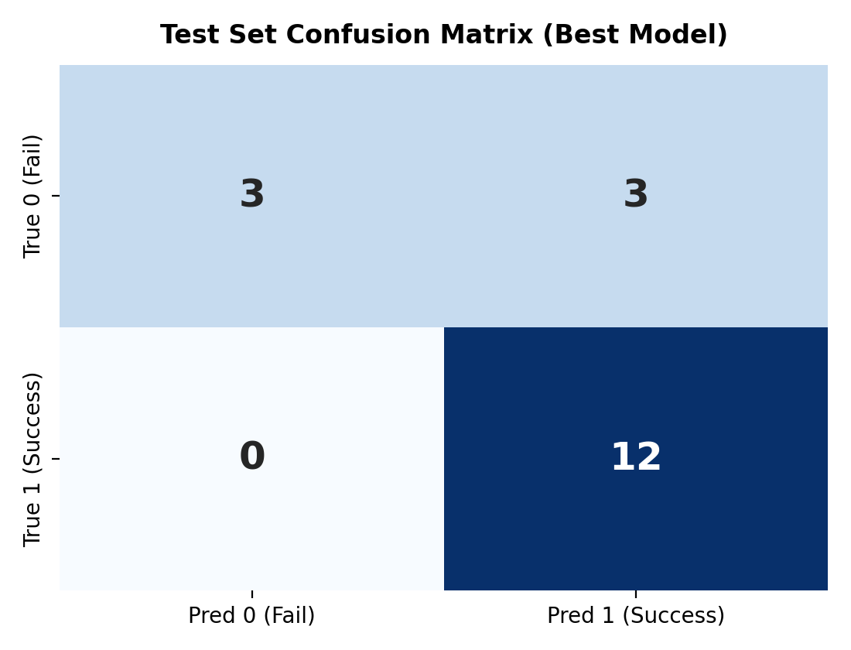
IBM DATA SCIENCE CAPSTONE PROJECT
Predictive Analytics: Machine Learning Models & Tuning
Model Training & GridSearchCV
Training Protocol: Split dataset 80% train / 20% test (test_size=0.2, random_state=2). Standardized features via StandardScaler.
Cross-Validation: Employed 10-fold GridSearchCV across Logistic Regression, SVM, Decision Tree, and KNN.
Confusion Matrix Analysis
Test Sample Metrics (N=18): True Positives: 12 | True Negatives: 3 | False Positives: 3 | False Negatives: 0.
Zero False Negatives: Model never predicts failure when a booster actually lands successfully (100% Recall for success).
GitHub Repository Reference: https://github.com/your-username/SpaceX-Falcon9-Landing-Prediction/blob/main/8_SpaceX_Machine_Learning_Prediction.ipynb

Slide 16
IBM DATA SCIENCE CAPSTONE PROJECT
Conclusion: Strategic Insights & Recommendations
Model Selection Rationale
Selected Best Model: Decision Tree Classifier (or Logistic Regression).
Test Accuracy: 83.33% across all classifiers with 87.14% CV training score.
Interpretability & Transparency: Decision Tree offers clear, rule-based decision paths directly mapping payload thresholds and launchpads to outcomes.
Operational Deployment: Lightweight footprint enables real-time pre-flight cost estimation within bidding software.
Actionable Business & Innovative Insights
Aerospace Bidding Strategy: Competitors should adjust bid pricing dynamically: if SpaceX launches from KSC LC-39A with Falcon 9 B5, their internal cost is ~$62M; competitors must offer value-add services rather than price matching.
Infrastructure Investment: SpaceX success is rooted in drone ship recovery (ASDS). Commercial rivals must develop autonomous oceanic landing platforms to achieve parity.
Space Insurance Underwriting: Insurers can discount launch premiums by up to 25% for flights utilizing flight-proven Block 5 boosters on high-margin orbits (SSO, GEO).
GitHub Repository Reference: https://github.com/your-username/SpaceX-Falcon9-Landing-Prediction

